Slide 1


Slide 2


Slide 3
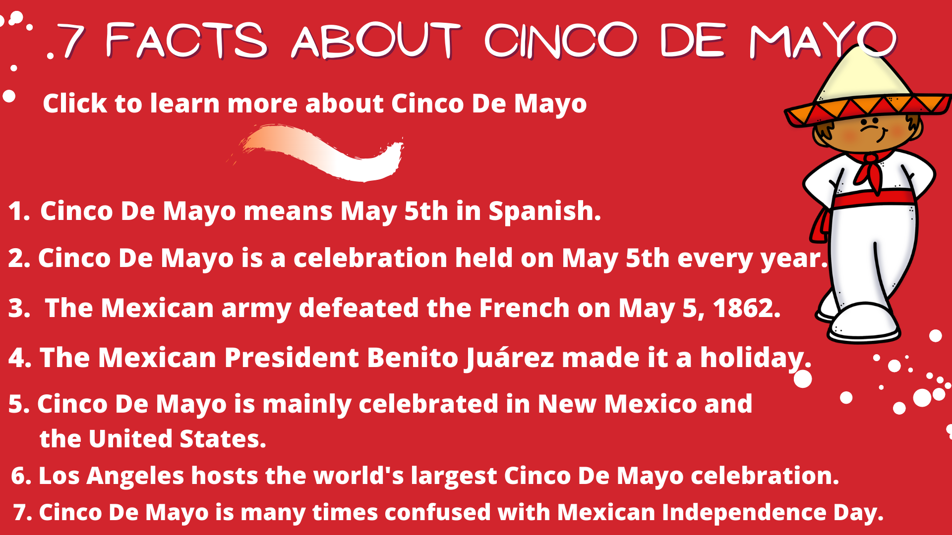
Watch

Slide 4
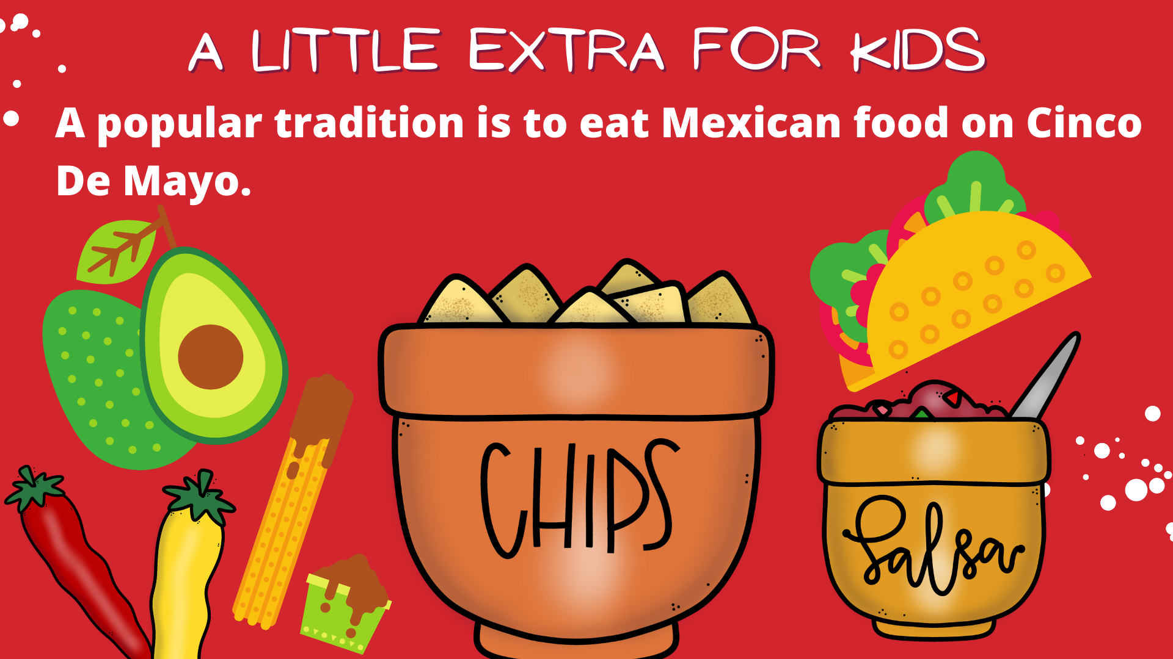

Slide 5


Slide 6
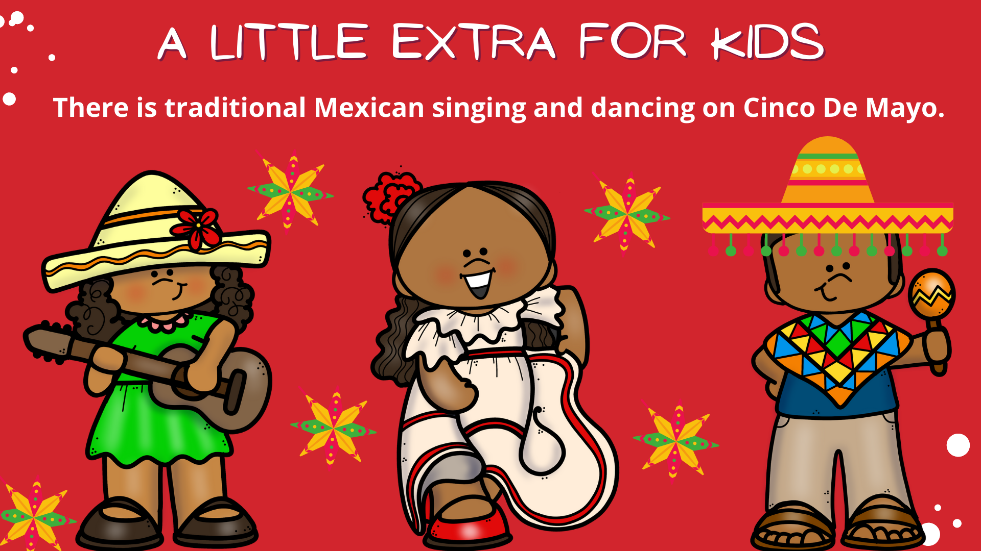

Slide 7


Slide 8
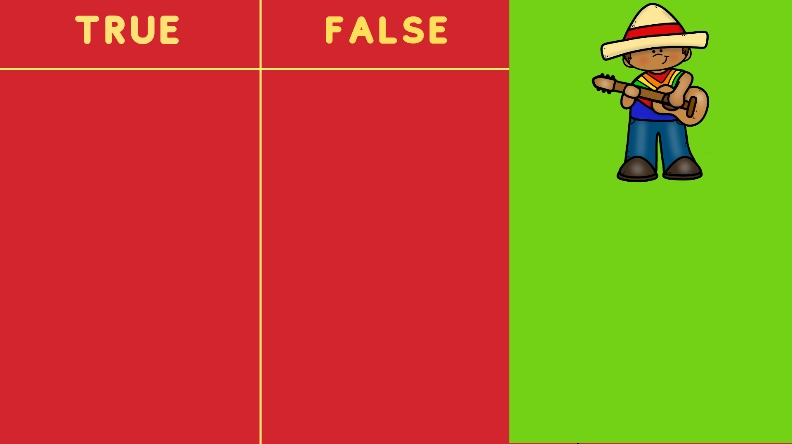
Cinco De Mayo is celebrated on May 10th.
Cinco De Mayo is a large celebration.
Manuel Stevens made Cinco De Mayo a holiday.
The Mexican Army beat the French in 1862.

Slide 9


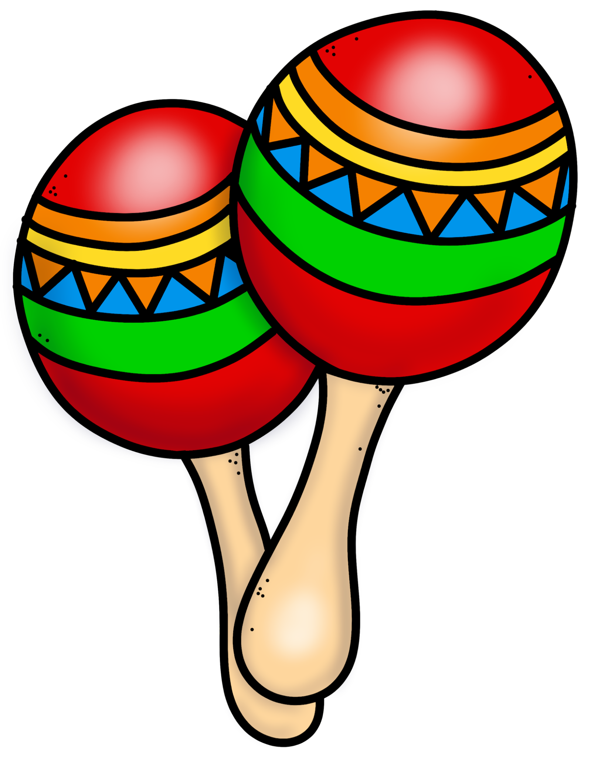


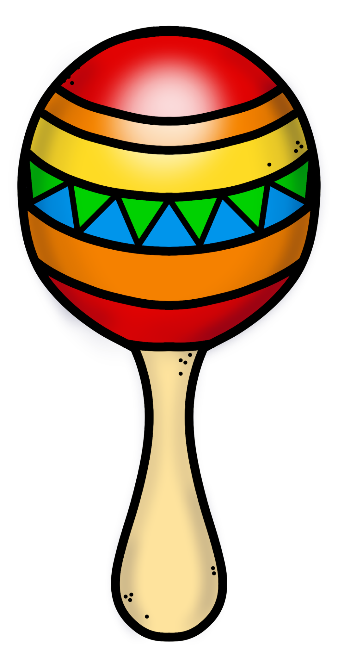
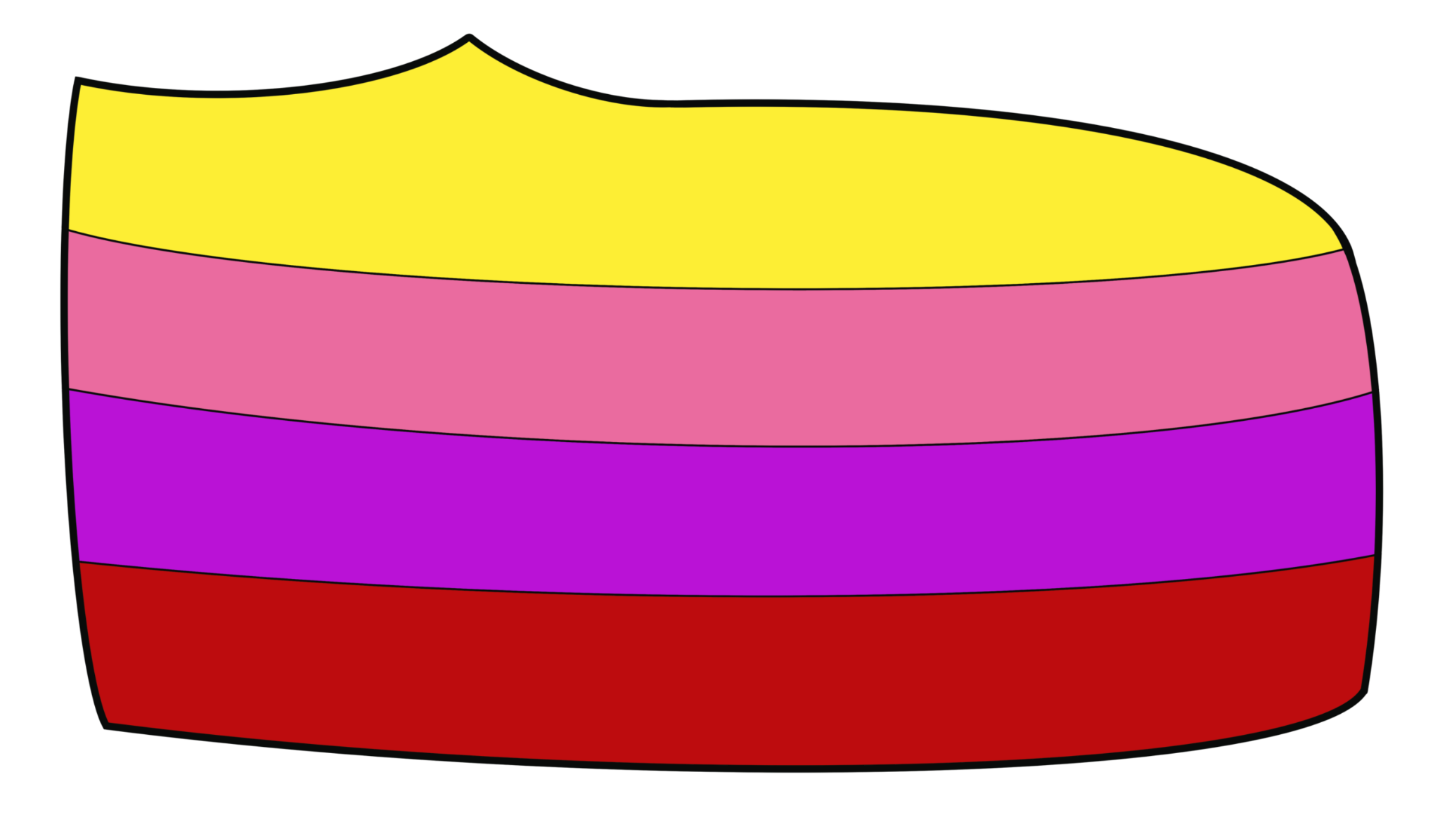


Slide 10
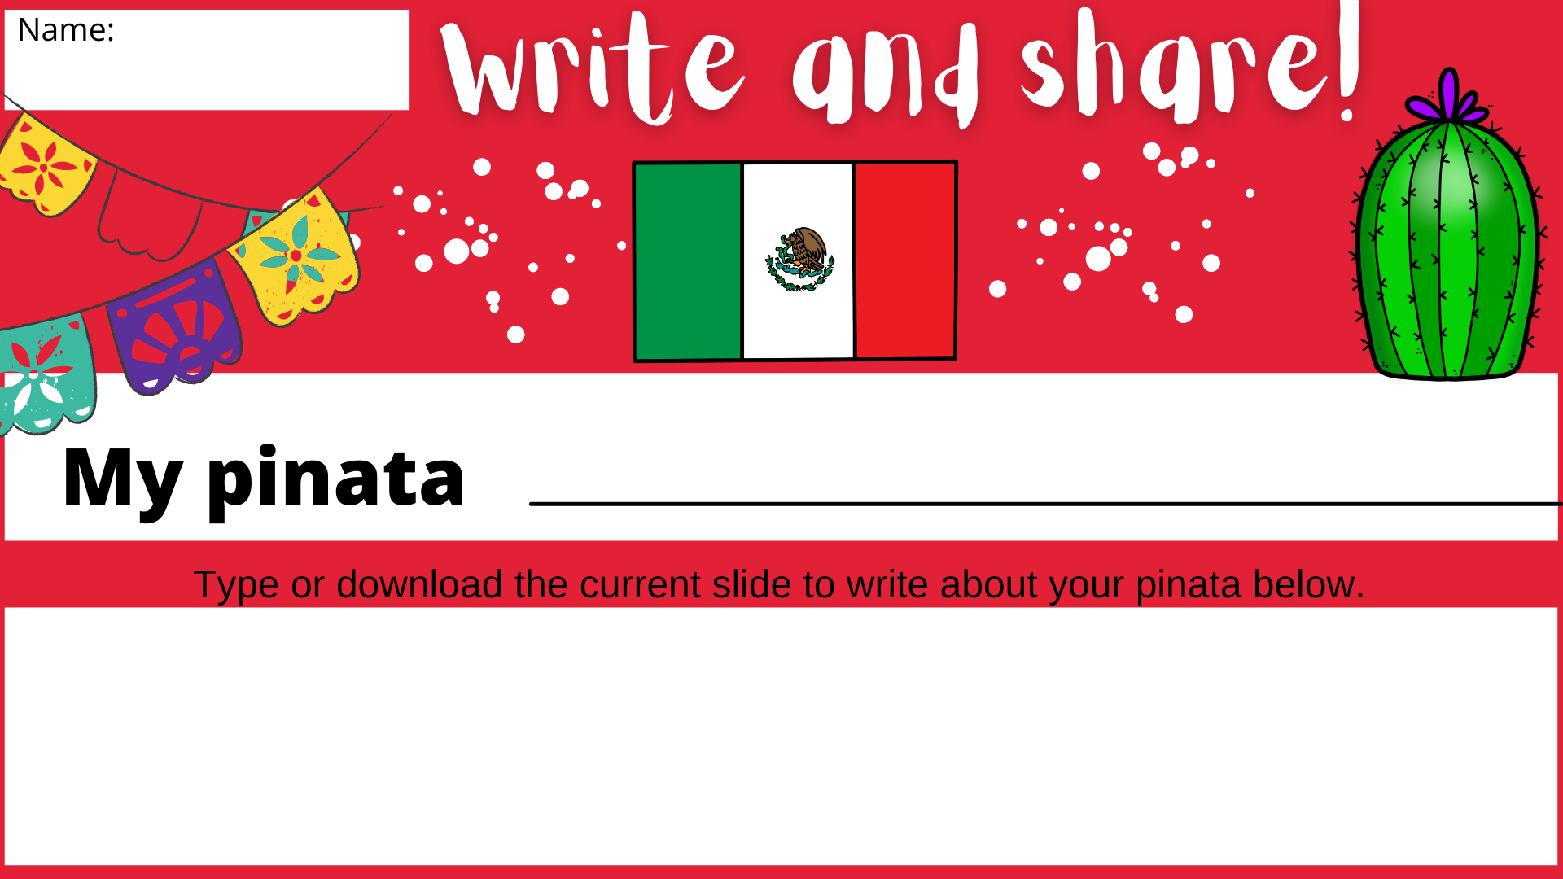

Slide 11
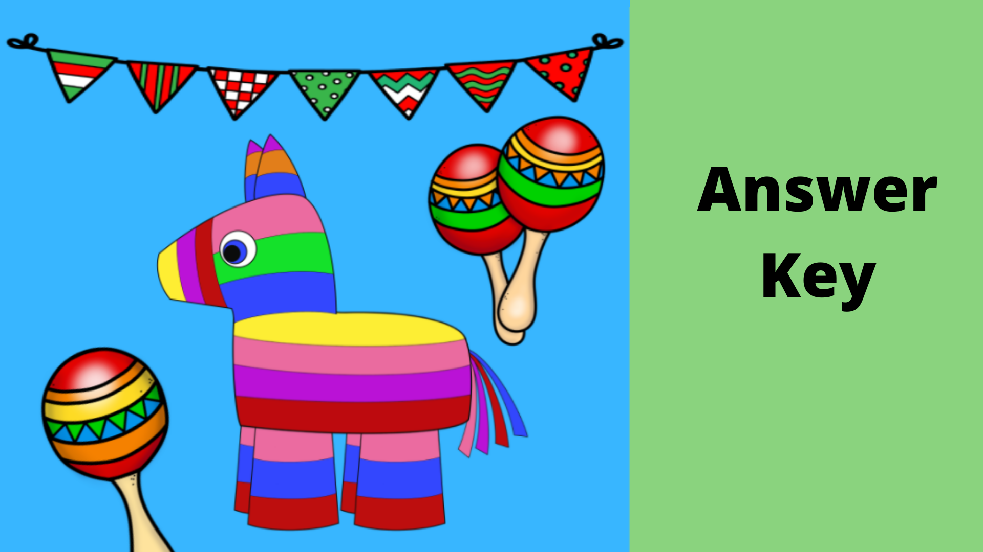

Slide 12
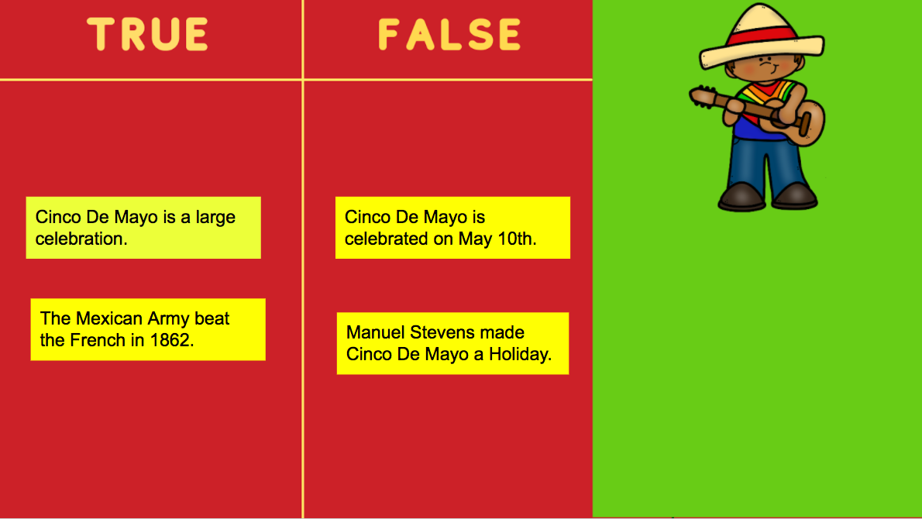

Slide 13


